Slide 1
Machine Learning in Wireless Medium Access Efficiency
CSE 4615

Slide 2
Summary of Existing Work

Slide 3
Selection of Machine Learning Techniques for Network Lifetime Parameters and Synchronization Issues in Wireless Networks

Slide 4
Summary
Machine learning strategies can be applied for dynamic networks, affecting self-learning and developing tools to react quickly and efficiently, with less human intervention and reprogramming
Machine learning techniques cannot be applied on Static networks so Conventional methods are used there
Machine Learning Algorithms on Issues in Wireless Network:
Issue: Localization
Problem: Difficulty in recognizing the physical and geographical location of a wireless node
Algorithms applied: Reinforcement Learning, K means, Support Vector Machine, Bayesian

Slide 5
Summary
Issue: Connectivity and Coverage
Problem: Difficulty in coverage of the target location by an optimal number of nodes, quickly and dynamically, without any lost information
Solution: Decision Tree, Deep-learning and evolutionary computation
Issue: Fault Detection
Problem: Detecting faults caused by deployment changes, resource limitations, accuracy between faulty and normal nodes, and type of surroundings represents complex obstacles
Solution: Random Forest, Principal Component Analysis, Independent Component Analysis, Deep Learning

Slide 6
Summary
Issue: Routing
Problem: . The purpose of efficient routing is to find the best optimal route that consumes the least resources in terms of power, while providing an increased lifetime.
Solution: Decision Tree, Random Forest, Evolutionary Computation
Benefits: Changes in surroundings can be adopted via machine learning without the need for reprogramming, while selecting optimum cluster heads in routing can minimize communication overheads. Additionally, by employing machine learning in applications, optimum paths can be found and latency reduced.

Slide 7
Summary
Issue: Congestion Control
Problem: If Data transmission is above the capacity of the communication channel; buffer overflows, packet collision, etc may occur. Congestion affects packet delivery ratio, quality of service, end-to-end latency, and energy consumption.
Solution: Reinforcement Learning, Random Forest, Decision Tree, Support Vector Machine, Principle & independent component analysis
Benefit: End-to end delay can be minimized by finding an optimal path, and traffic can be estimated by accurately using machine learning algorithms

Slide 8
Summary
Issue: Medium Access Control
Solution: Reinforcement Learning, Random Forest
Benefit: Machine learning techniques for medium access control has advantages that include avoiding latency, reducing energy consumption, reducing extra efforts to reconstruct the network by adding nodes or removing dead nodes, minimizing end-to-end delay, and enhancing the efficiency of self-learning in the network

Slide 9
Multi-Agent Reinforcement-Learning-Based Time-Slotted Channel Hopping Medium Access Control Scheduling Scheme

Slide 10
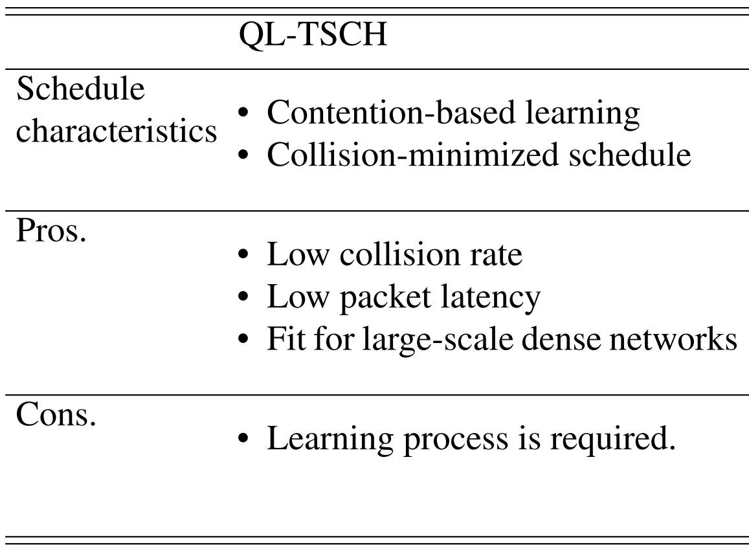
Summary
Scheduling without collision has low throughput.
Contention-based scheduling has higher collisions.
Multi-agent RL-based TSCH scheduling scheme allows contention but minimizes collisions.
Q-Learning, a specific RL machine learning method, is used to learn the best transmission slot.

Slide 11
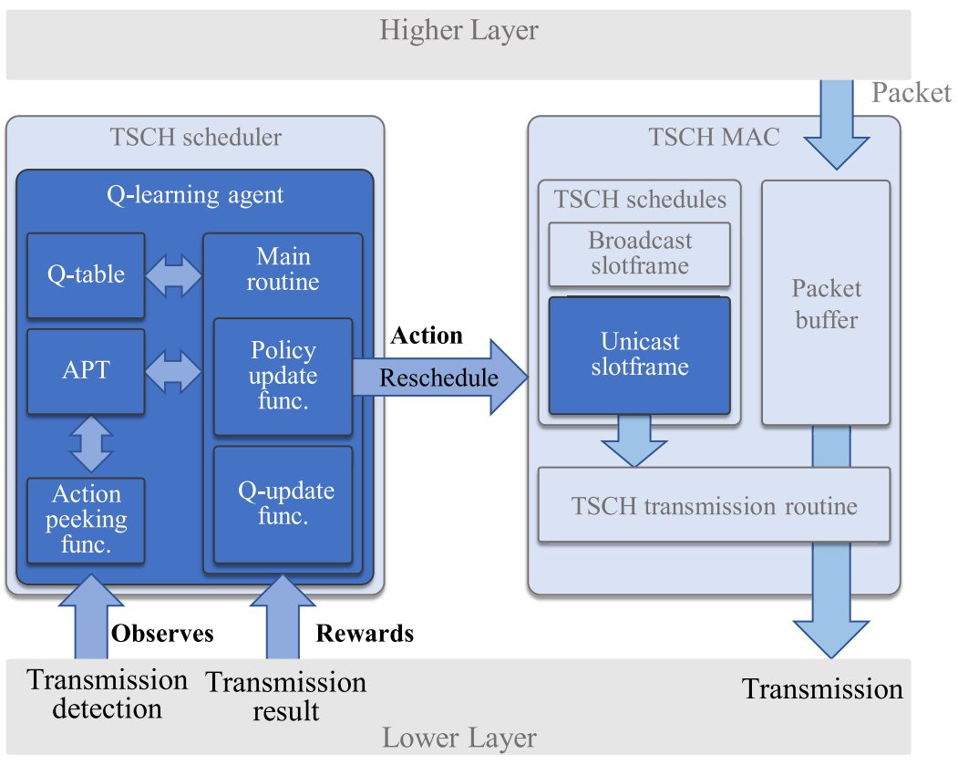
Summary
Proposed scheduler learns the transmission slot with the lowest transmission failure rate and transmits only in that slot.
It is autonomous and does not require additional communication to distribute or create schedules.
Multi-agent RL is applied in a TSCH scheduling algorithm for the first time.
Action peeking is proposed to address the non-stationarity problem in multi-agent RL.

Slide 12
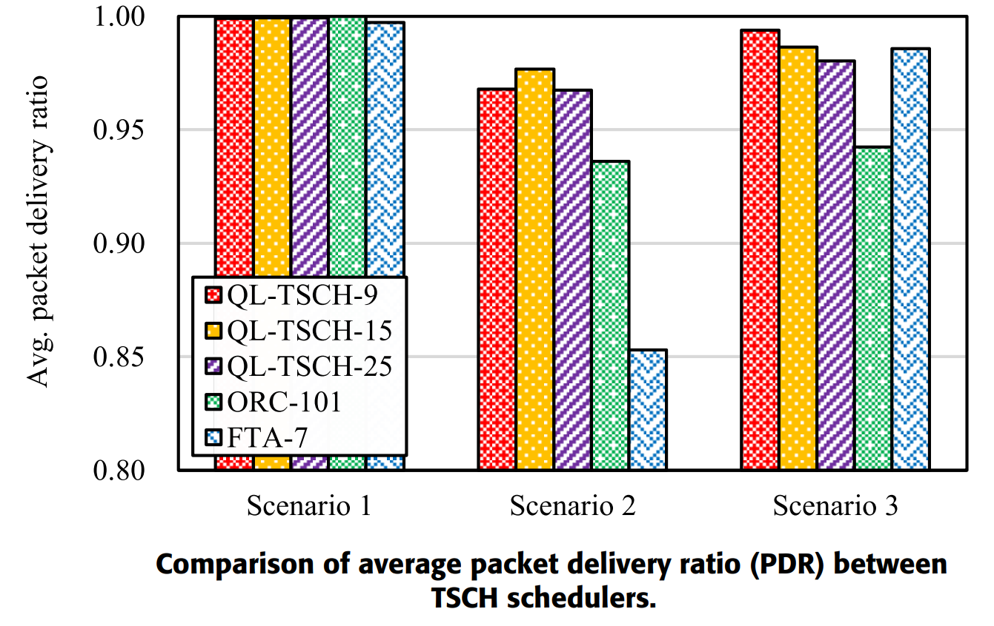
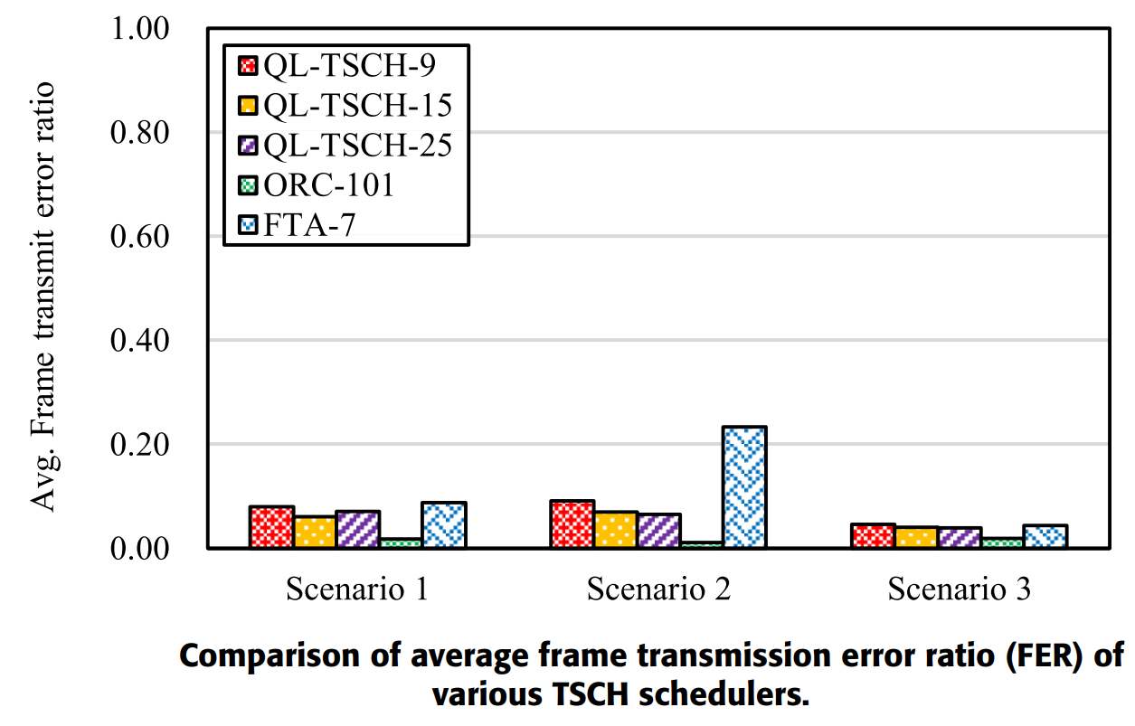
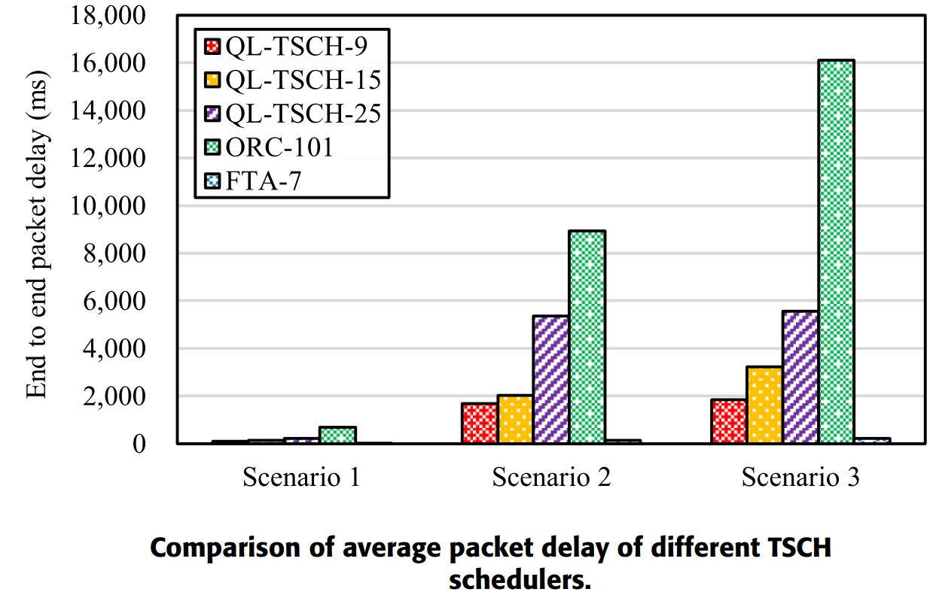
Performance
The performance of the TSCH scheduler was consistently good for various applications, compared with other schedulers

Slide 13
Learning Based Frequency and Time-Domain Inter-Cell Interference Coordination in HetNets

Slide 14
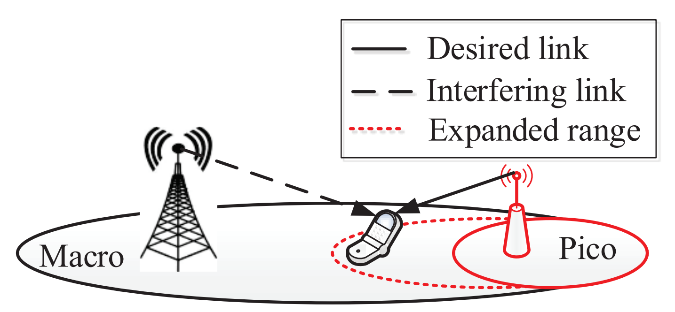
Issues
Concentrates on downlink transmission in inter-cell interference coordination (ICIC) techniques used in heterogeneous networks
Macro cells have a stronger downlink, which might cause devices to connect to it instead of to their closest picocell
Causes the macrocell to become overloaded

Slide 15
Solution
Cell Range Expansion (CRE) used to combat this and prioritize picocells
May cause low SINR by adding a bias value
Paper uses CRE in a way that does not cause low SINR
Requires picocells to be self learning
Works on both time and frequency domains
Provides decentralized solutions for joint power control and cell association
Network leans appropriate bias value to add to a specific picocell by coordinating between the other picocells and the macrocells
Most papers before this assumed the same bias value for all the picocells, which was less efficient
Learning based on Reinforcement Learning, which was previously unseen
Difficulty lies in reducing load from the macrocells without affecting the QoS requirements of the users

Slide 16
In-Depth Analysis

Slide 17
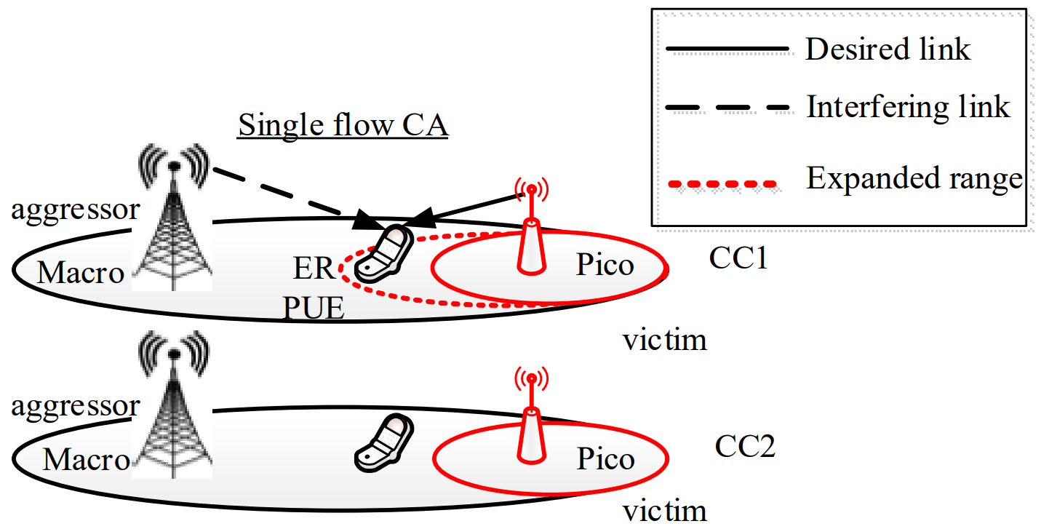
Frequency Domain
Discussing paper titled “Learning Based Frequency and Time-Domain Inter-Cell Interference Coordination in HetNets”
Deals with time and frequency domains separately
Frequency Domain ICIC:
CRE is of two types, single flow and multi flow.
For single flow, a single channel is used to perform CRE so that only that channel is used by the receiver.

Slide 18
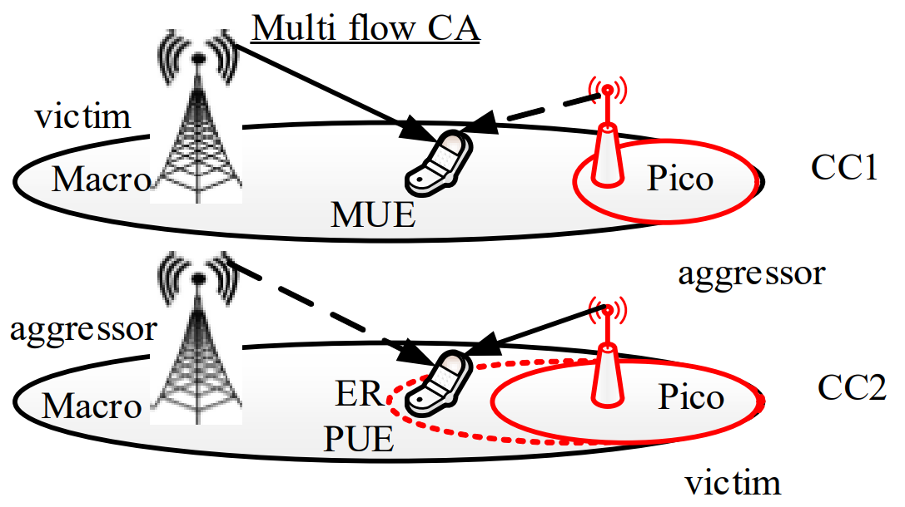
Time and Frequency Domains
In multiflow, CRE is still performed on just one channel, but the microcell continues to serve data on the other channel
Multiflow is better since multiple base stations can be used to transmit data to the receiver
Requires coordination between the macro and pico cells
Approach in frequency domain has 3 levels: select optimal CC to use, select CRE value and select power level.

Slide 19
Time and Domain
Time Domain ICIC:
2 level approach with loose coordination between picocells and macrocells.
Network autonomously optimizes the CRE value of the picocells
Picocells dynamically learn transmission power in order to maintain QoS
Macrocells decrease their power levels accordingly to discourage their use
One approach uses Q-learning and concentrates on optimizing load while minimizing quality loss
Another approach uses game theory and concentrates on achieving the optimal quality satisfaction equilibria
First approach is less selfish since picocells sacrifice quality to an extent
Second approach is more selfish for a specific picocell since it does not change anything as long as its satisfactory quality level is met

Slide 20
Observations
Increasing CRE without ICIC results in low data rates at cell edges
Static QL Learning has high data rates but poor performance at cell edges
Proposed dynamic QL Learning has best performance
3-fold increase in average cell-throughput by activating eight picocells
Yields the best performance after convergence
Multi flow dynamic QL algorithm shows a performance improvement of 47% on average
Multi flow dynamic QL algorithm outperforms the other algorithms in terms of total throughput

Slide 21
References
Srilakshmi, Nimmagadda, and Arun Kumar Sangaiah. "Selection of machine learning techniques for network lifetime parameters and synchronization issues in wireless networks." Journal of Information Processing Systems 15.4 (2019): 833-852.
Park, Huiung, et al. "Multi-agent reinforcement-learning-based time-slotted channel hopping medium access control scheduling scheme." IEEE Access 8 (2020): 139727-139736.
Simsek, Meryem, Mehdi Bennis, and Ismail Güvenç. "Learning based frequency-and time-domain inter-cell interference coordination in HetNets." IEEE Transactions on Vehicular Technology 64.10 (2014): 4589-4602.

Slide 22
Thank You

